Slide 1
UCI-LSTM and BiLSTM

Slide 2
Dataset
Dataset has 6 activities present: walking, walking upstairs, walking downstairs, sitting, standing, Laying.
Used processed version of UCI-HAR Dataset where instead of raw signals, it has 561 Numerical features.
Total 10,299 samples each 561 features.
Sensors used: Accelerometer, Gyroscope.
Limitation of CSV version:
The CSV version contains extracted statistical features rather than raw sequential signals. Therefore, temporal information is partially reduced during preprocessing.

Slide 3
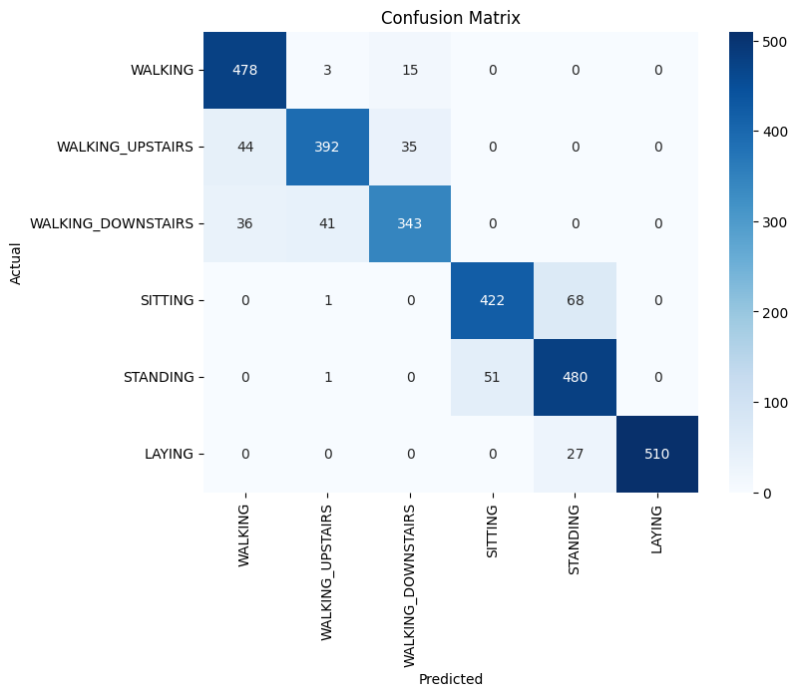
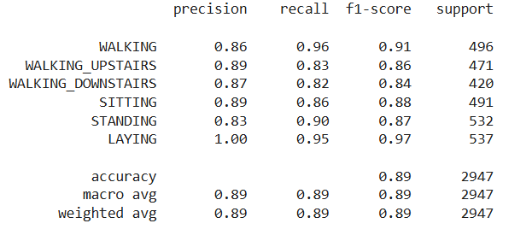
LSTM Results
Train accuracy = 97%

Slide 4

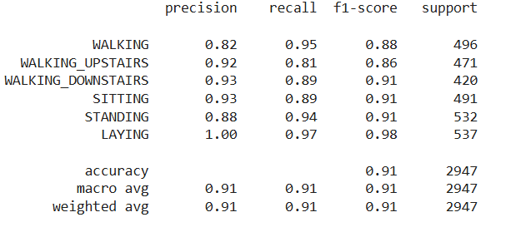
BiLSTM Results
Train Accuracy = 99.3%

